Slide 1
Cryptography (5830)
Jr qrirybc cvbarrevat yrnqref sbe gur qvtvgny ntr
Notes:
We develop pioneering leaders for the digital age.

Slide 2
Cryptography: “Hidden writing”
Study and practice of building security protocols that resist adversarial behavior
Blend of mathematics, engineering, computer science

Slide 3
Cryptography use cases

Slide 4
Crypto is foundational
Failures highlight dependency on good crypto:
WWII
Government sabotage
Playstation 3 crack
Wireless keys for cars
Password cracking
WEP attacks
Many TLS vulnerabilities
…

Slide 5
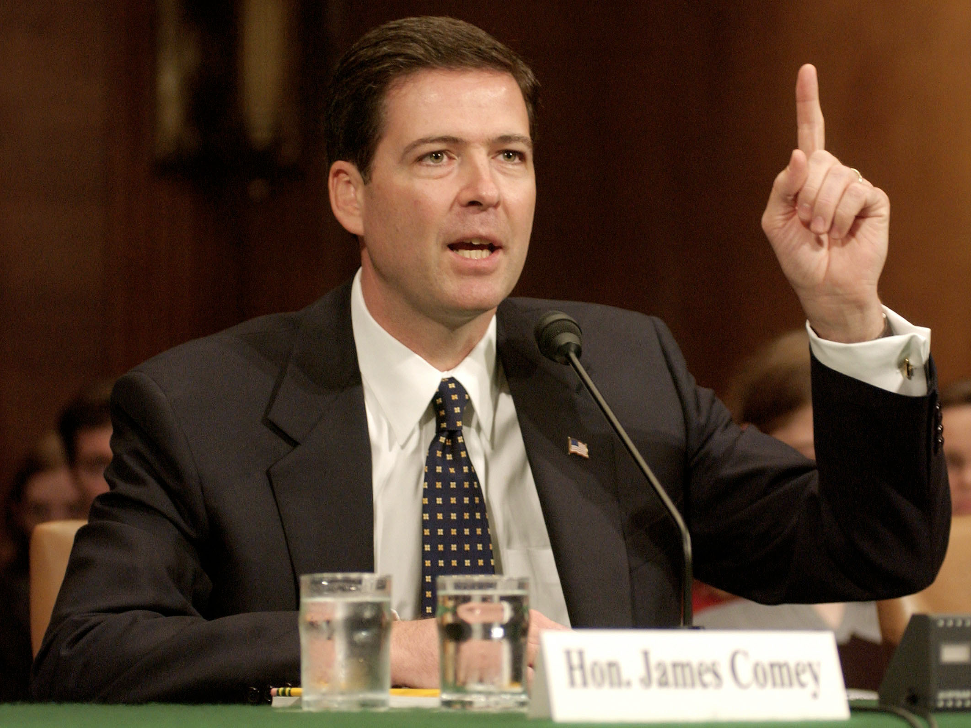
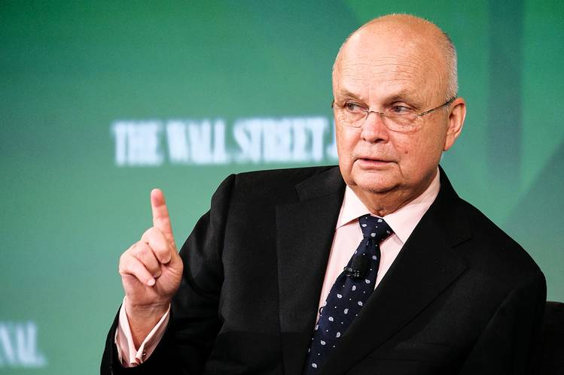
Google:
“keys under doormats”
Google:
“report on smartphone encryption
and public safety”

Slide 6
Symmetric encryption
Symmetric = secret key shared between sender and recipient
Functionality (correctness)
Security
Capabilities of attacker
Goals
Notes:
Draw picture. Start with just alice and bob. Have a channel in between. What do we do?
Give definition of a scheme
Two big issues in security: capabilities and goals

Slide 7
Auguste Kerckhoffs’ (Second) Principle
(circa 1883)
“The system must not require secrecy and can be stolen
by the enemy without causing trouble”
A cryptosystem should be secure even if its algorithms, implementations, configuration, etc. is made public --- the only secret should be a key
Why?

Slide 8
Some attacker capabilities
Unknown plaintext
attacker only sees ciphertext(s)
Known plaintext
attacker knows some plaintext-ciphertext pairs
Chosen plaintext
attacker can choose some plaintexts and receive encryptions of them
Chosen ciphertext
Attacker can see encryptions of chosen plaintexts and decryptions of chosen ciphertexts
Side-channels such as timing, length, partial bits of keys, knowledge of bad key distribution, etc.

Slide 9
Attacker goals?
Notes:
Use as running example the substitution cipher from first slide to guide discussion of attacker goals: key recovery, message recovery will come up.
Are these definitions suitable for security? Go through exercise of showing how key recovery resistance or message recovery resistance is not good (partial message recovery)

Slide 10
Shannon’s security notion
(1949)
Def. A symmetric encryption scheme E is perfectly secure if
for all messages M,M’ and ciphertexts C
Pr[ E(K,M) = C ] = Pr[ E(K,M’) = C ]
where probabilities are over choice of K
In words:
each message is equally likely to map to a given ciphertext
In other words:
seeing a ciphertext leaks nothing about what
message was encrypted
Does a substitution cipher meet this definition?
No!

Slide 11
One-time pads
Fix some message length L
Key generation: output random bit string K of length L
E(K,M) = M K
D(K,C) = C K

Slide 12
Shannon’s security notion
(1949)
Def. A symmetric encryption scheme is perfectly secure if
for all messages M,M’ and ciphertexts C
Pr[ E(K,M) = C ] = Pr[ E(K,M’) = C ]
where probabilities are over choice of K
Thm. OTP is perfectly secure
For any C and M of length L bits
Pr[ K M = C ] =
1 / 2^{L}
Pr[ K M = C ] =
Pr[ K M’ = C ]

Slide 13


Internet
http://amazon.com
M K
Does OTP provide a secure channel?
Integrity easily violated
Reuse of K for messages M,M’ leaks M M’
Encrypting same message twice under K leaks the message equality
K must be as large as message
Message length revealed
Notes:
This is probably too boring. Focus on a new, cool application. Something people aren’t expecting. On-line shopping is circa 2000. Let’s get something more hip. (Defer to later.)
Actually perhaps this is okay spin: this is a pretty pedestrian application, but in fact it’s quite difficult to render secure!

Slide 14
Security notions are hard to get right

Slide 15
Some basic primitives
Symmetric cryptography (shared key K)
encryption & decryption using K
message authentication using K
pseudorandom functions (PRF)
Public-key cryptography (public key pk, secret key sk)
encrypt with pk and decrypt with sk
digitally sign using sk and verify with pk
Hash functions (no keys)
used to “compress” messages in a secure way

Slide 16
The cryptography stack
Abstract tools
Length-extending
Encryption
Cryptanalysis
Length-preserving
Encryption
TLS
SSH
PGP
Password hashing
Constructions
AES-GCM, OCB,
CTR mode + CMAC
RSA-OAEP
Signed
Diffie-Helman
key exchange
Cryptanalysis
Security reductions
“provable security”
FFX, EME
CBC mode,
CTR mode,
ECB mode
RSA-PKCS#1
v1.5
PBKDF2
Basic primitives
AES
SHA256
RSA
Elliptic curve groups
Cryptanalysis

Slide 17
Some goals for course
Learning to speak crypto
What primitives are generally for
What are the security targets associated with them
Current best practices for cryptographic constructions you are likely to encounter
Understand why they are considered best
Know how to break some inferior choices
You should be able to build crypto libraries exposing clean, easy-to-use interfaces
Using someone else’s implementations of primitives

Slide 18
Administrative
Some details at https://github.com/cornelltech/CS5830-Spring16
Big things:
Homework assignment (Python coding)
Final of some sort (Details TBA)
Participation
Projects
TA: Rahul Chatterjee

Slide 19
Projects
Non-trivial crypto feature implemented
For your startup project
Other group’s startup project (need to sort IP)
Social good project (HRW, ACLU)
Solo or in small teams (2 or 3)
Initial proposals will be due to me Feb 23, in-class pitches Feb 25

Slide 20
Homework for next week
Give 1 or more examples of cryptography use in your company challenge projects from last semester
Could be code you touched, could not be
Extra credit points if I’ve never heard of the use case
Double extra credit points if you explain a meaningful, non-trivial attack
Prepare a few sentence description, discussing application, security goals, pointer to (open source) code
Tuesday we will have some people present

